Slide 1




University Institute of Engineering
Department of Computer Science & Engineering
COMPUTER ORGANIZATION & ARCHITECTURE
(23CST-204/23ITT-204)
ER. SHIKHA ATWAL
E11186
ASSISTANT PROFESSOR
BE-CSE

Slide 2
INSTRUCTION SET CLASSIFICATION
The instruction set of any processor broadly fits into the categories as in figure below along with examples. The first five categories are mandatory while the next four are generally
available in advanced or new generation processors. The Instruction set is part of the Instruction Set Architecture (ISA). Therefore, the Data path, the Registers, Memory Interface and the Instruction set, altogether ensure the design of the CPU and its best utilization. The number of instructions for a processor may range from less than 100 to few hundreds plus. It is noteworthy, that a large number of instructions does not imply that the processor is powerful. More often, to provide downward compatibility within the processor family variants of each instruction adds up to the list, making the set larger.

Slide 3
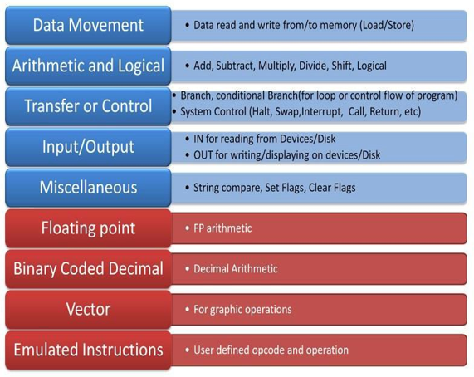
Generic Classification of Instruction Set

Slide 4
Generic types of instructions are already discussed in previous chapters. Let us understand others and previous ones in brief.
For easy understanding, the examples are written in the mnemonic code. R refers to register in CPU, any name refers to the variable.
First part is the instruction mnemonic.
The example instructions do not pertain to any particular CPU.
Data Movement Instructions: These support movement of data between registers, registers to memory, memory to register. Few CPU support memory to memory movement of data too. Data movement instructions are named as either “Move” or Load/Store” instructions. This category is most frequently used by CPU while executing program code.

Slide 5
For example:
Move R1, Total
Move Total, R1
Load R1, Total
Store R1, Total
Arithmetic and Logical Instructions: This category of instructions carry out calculations. The minimum in this category is ADD, SUB, AND, OR, XOR, SHIFT. Multiply and Divide can always be emulated using successive addition or subtraction. This was the case in very early systems. However, MULTIPLY and DIV are part of the instruction set as hardware execution is more efficient than emulation. Few CPUs have CMP (Compare) instruction.

Slide 6
The logical instructions are required to implement the condition checking of "For Loops, While Loops, IF, etc..".
At the end of execution of arithmetic and logical instructions, depending on the result in Accumulator, Condition Codes (Zero, Sign, Overflow, carry – ZSOC) are set, implying the outcome of the instruction execution. Generally, these flags are useful in controlling the flow of the program. For example:
ADD R1, TOTAL
ADD R1, R2, R3
XOR R4, TOTAL
MUL R4, MARKS

Slide 7
Transfer or Control Instructions: This category of instructions facilitate change in program flow described by the control structures in the high-level language. BRANCH or JMP instructions along with Condition Code flags achieve the requirement. Subroutine CALLS, RETURNS are categorized here.
For example:
JMP LABEL1 ;Jump
JNZ LABEL2 ;Jump on not zero
BZ LABEL2 ;Branch on Zero
BNE LABEL3 ;Branch on not Equal

Slide 8
Input/Output Instructions: There are two ways of doing Input/Output operations. Intel family uses In and Out Instructions on the I/O registers for communication or data transfer with I/O devices. These I/O registers are numbered as Ports. Motorola family uses Data movement instructions assigning memory addresses to I/O registers. The former is called I/O mapped I/O whereas the latter is called Memory-mapped I/O.
For example:
IN Port#232
OUT Port#234
Move R1, #FFEE

Slide 9
Miscellaneous Instructions: NOP (No Operation) is a famous dummy instruction but a very useful one in this category. Some of the CPUs allow user-defined interrupt. These interrupts can be activated using Instructions. HALT is another very important instruction which brings the system to halt when "Shutdown". System Control is either grouped here or as Control Instructions.
For example:
HALT
NOP
INT

Slide 10
Floating Point Instructions: We had seen in the previous chapter that specialised hardware is required for efficient Floating-point operations. This hardware works independently of the CPU. Floating-Point Arithmetic instructions with unique opcode are helpful.
FLD FP Load
FST FP Store
FADD FP ADD
FSUB FP Subtract
FMUL FP Multiply
Binary Coded Decimal Instructions: Decimal Number system hardware speeds up decimal calculations. In the absence of this hardware, every time conversion to binary and reverse conversion to decimal is required. Similar to floating arithmetic instructions specialized decimal hardware is available.

Slide 11
Vector Instructions: This group is specific to display. Graphic operations like zoom, resize, flip etc require heavy calculations on Vector basis. Matrices operations utilize vector instructions.
Emulated Instructions: User-defined opcode and operation fall into this category. Very few CPU support this type.

Slide 12
CPU architecture design radically differs based on the size of the Instruction set. Accordingly, there are two categories namely Reduced Instruction Set Computer (RISC) and Complex Instruction Set Computer (CISC).
As the name implies, RISC has fewer instructions in the set and CISC has a large number of instructions. No matter, both are equally functionally complete. MIPS, ALPHA, PA-RISC, Intel i860, Motorola 88000, ARM are all examples of RISC CPU. Intel X86 series, Motorola 68K series, VAX are all examples of CISC CPU. Frequently we will be referring to RISC and CISC. The trade-off is between the size of the program code and the simplicity in decoding the instructions by the hardware.

Slide 13
INSTRUCTION SET FORMATS
The Instruction Set Format defines how an instruction is structured in a computer system, specifying the arrangement of various fields that encode information for the processor to execute. The format typically includes fields like the opcode, operands, and sometimes additional metadata.
Basic Fields in an Instruction Format
Opcode (Operation Code):
Specifies the operation to be performed (e.g., ADD, SUB, MOV).
Determines the type of operation (arithmetic, logical, data transfer, etc.).

Slide 14
2. Operand(s):
Specifies the data to be used in the operation. This could be:
Registers: Data stored in processor registers.
Memory Addresses: Direct or indirect locations in memory.
Constants/Immediate Values: Fixed values provided in the instruction.
3. Addressing Mode:
Defines how the operand is interpreted (immediate, direct, indirect, indexed, etc.).
4. Instruction Length:
Specifies the number of bits used to represent the entire instruction (e.g., 16-bit, 32-bit, 64-bit).

Slide 15
Key Considerations in Instruction Formats
Length of the Instruction:
Shorter instructions save memory but may limit functionality.
Longer instructions can encode more information.
Number of Operands:
Affects the instruction size and flexibility.
Zero to three operands are common.
Addressing Modes:
Determines the way operands are accessed, influencing instruction complexity.
Ease of Decoding:
Fixed-length formats simplify decoding but may waste memory.
Variable-length formats save memory but complicate decoding.

Slide 16
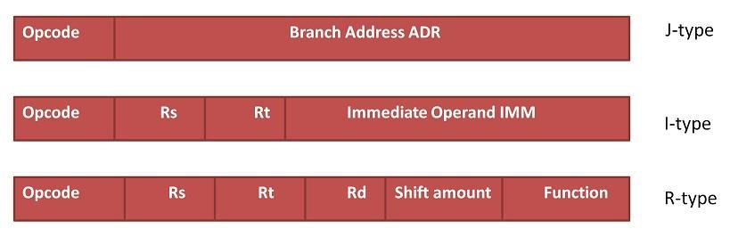
Types of Instruction Formats
Encoding of Instructions is called Instruction Format. There are two generic ways to encode instructions.
1. Fixed length Instruction Format: RISC uses fixed-length encoding in which each Instruction occupies the same amount of space. The length of the instruction is fixed irrespective of the opcode. It simplifies instruction decoding.
An example of Fixed Length Instruction format – MIPS series

Slide 17
MIPS series is a RISC processor. It simply has 3 variants of formats but all have the same word length. Also, it is observed that registers are used than the memory in referencing operands.
2. Variable Length Instruction Format: CISC uses variable-length encoding in which each instruction occupies only the space required by it to convey the operands. No redundant use of memory space. It allows compact representation of instructions but complicates decoding.

Slide 18
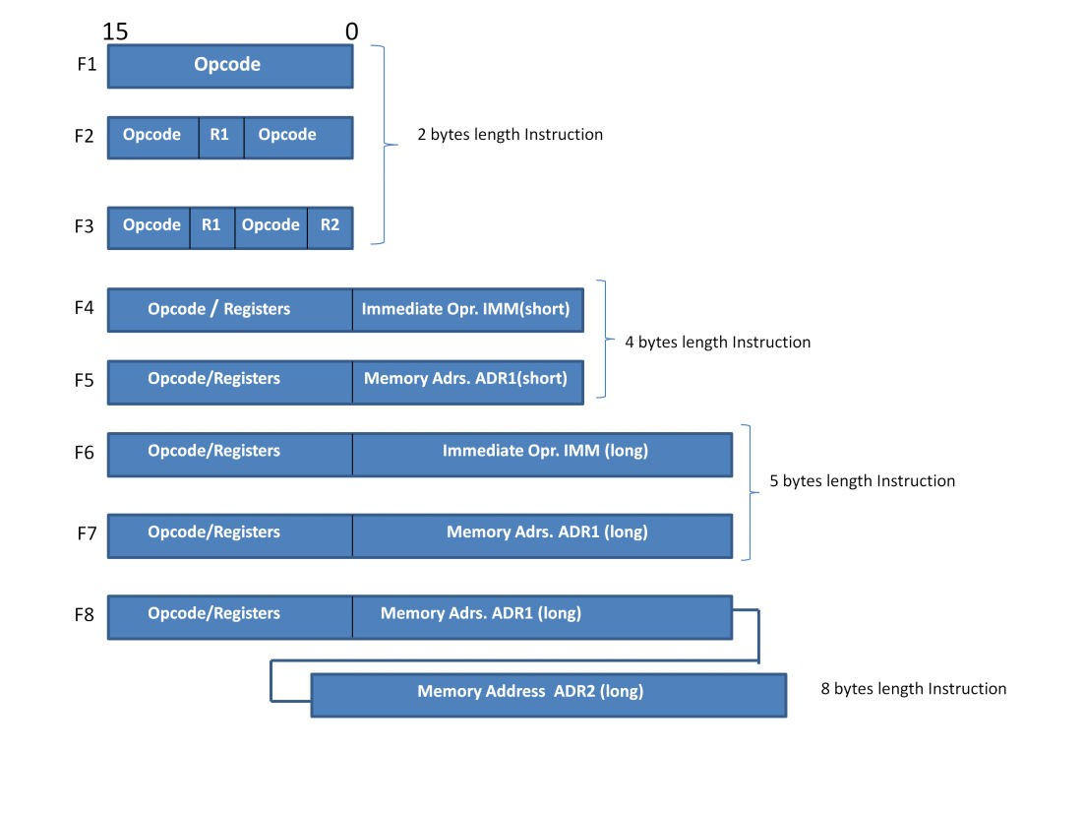
This is a supportive figure to understand the characteristics of a variable-length format. As you see, there 8 ways in which the instruction is encoded varying from 2 bytes length to 8 bytes length. It is observed that the length differs depending upon the way the operand address is conveyed.
An example of Variable Length Instruction format with Motorola M6800 CISC CPU

Slide 19
Common Instruction Formats
In terms of specifically related to instructions, there are three other types of Instruction set formats.
Three-Address Format
Used when three operands are specified (source1, source2, destination).
Example:
ADD R1, R2, R3 ;R1 = R2 + R3
Format: Opcode | Source1 (R2) | Source2 (R3) | Destination (R1)

Slide 20
Two-Address Format
Used when two operands are specified. The result is stored in one of the source operands.
Example:
ADD R1, R2 ;R1 = R1 + R2
Format: Opcode | Source/Destination (R1) | Source (R2)

Slide 21
One-Address Format
One operand is implied (usually the accumulator).
Example:
ADD A ;AC = AC + A
Format: Opcode | Address (A)

Slide 22
Zero-Address Format (Stack-Based)
Operands are implied to be on the top of the stack.
Example:
ADD ;TOS = (TOS - 1) + TOS
PUSH
POP
Format: Opcode

Slide 23
Exercise:
Write the below expression in all address formats of instructions.
X = (A+B)*(C+D)

Slide 24
X = (A+B)*(C+D) in Three Address Format
ADD R1, A, B ;R1=M[A]+M[B]
ADD R2, C, D ;R2=M[C]+M[D]
MUL X,R1, R2 ;M[X]=R1*R2
X = (A+B)*(C+D) in Two Address Format
MOV R1, A ;R1=M[A]
ADD R1, B ;R1=R1+M[B]
MOV R2, C ;R2=M[C]
ADD R2, D ;R2=R2+M[D]
MUL R1, R2 ;R1=R1*R2
MOV X, R1 ;M[X]=R1

Slide 25
X = (A+B)*(C+D) in One Address Format
LOAD A ;AC=M[A]
ADD B ;AC=AC+M[B]
STORE T ;M[T]=AC
LOAD C ;AC=M[C]
ADD D ;AC=AC+M[D]
MUL T ;AC=AC*M[T]
STORE X ;M[X]=AC

Slide 26
X = (A+B)*(C+D) in Zero Address Format
PUSH A ;TOP=A
PUSH B ;TOP=B
ADD
PUSH C ;TOP=C
PUSH D ;TOP=D
ADD ;TOP=C+D
MUL ;TOP=(C+D)*(A+B)
POP X ;M[X]=TOP

Slide 27
References Reference Books:
J.P. Hayes, “Computer Architecture and Organization”, Third Edition.
Mano, M., “Computer System Architecture”, Third Edition, Prentice Hall.
Stallings, W., “Computer Organization and Architecture”, Eighth Edition, Pearson Education.
Text Books:
Carpinelli J.D,” Computer systems organization &Architecture”, Fourth Edition, Addison Wesley.
Patterson and Hennessy, “Computer Architecture” , Fifth Edition Morgaon Kauffman.
Reference Website
Instruction Set Architecture : Instructions and Formats | Computer Architecture (witscad.com)

